Slide 1
Understanding the Proposed University Data Center
March, 2026

Slide 2
Data Centers Overview
Section

Slide 3
What is a Data Center?
A facility that houses the computing infrastructure needed to store, process, and deliver data
Provides the backbone for applications, cloud services, AI research and digital communication
Every business, educational institution, and every digital device (cell phone, car, refrigerator, etc.) utilizes a data center to run its operations.

Slide 4
Data Center Components
Data Centers are made up of six main components which will be detailed in the following slides.
Servers
Storage
Network Infrastructure
Cooling Systems
Power Systems
Physical Security

Slide 5
What are the Different Types of Data Centers?
Notes:
omit text

Slide 6
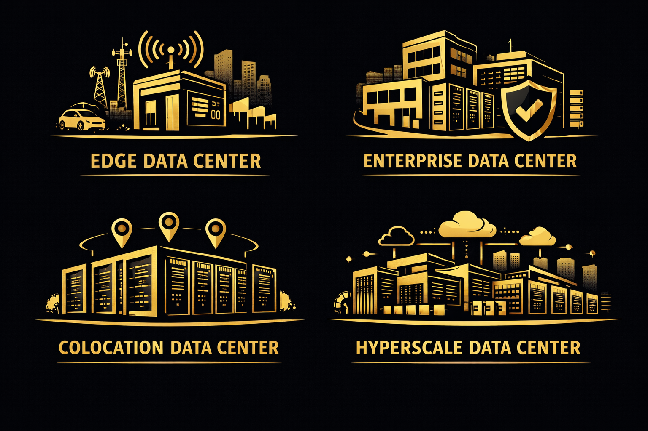
Edge Data Centers
Small, in close proximity to the people and devices they serve.
Reduces delays by processing data near its source rather than at a distant central facility.
Often deployed in micro or modular formats.
Examples: autonomous vehicles, robotics, etc.

Slide 7
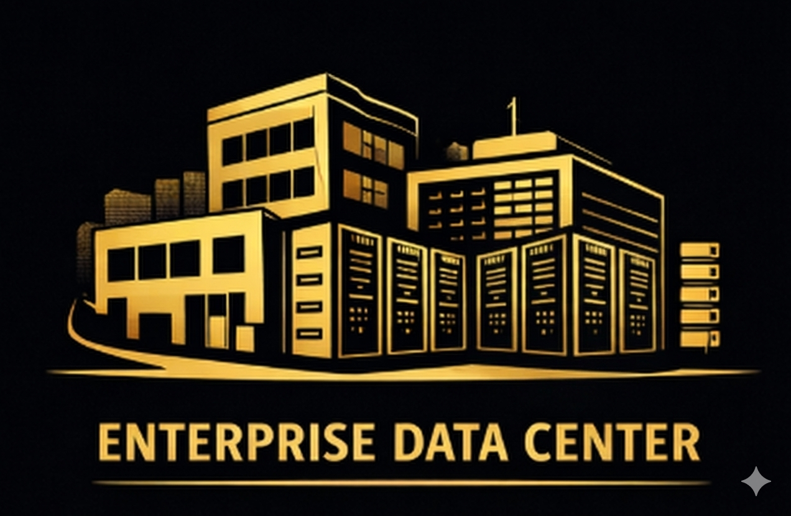
Enterprise Data Centers
Small to medium sized.
Owned and operated by a single organization for its own exclusive use.
Located on-site or at a dedicated off-site facility.
Examples: OU’s data center and MATILDA.

Slide 8
Colocation Data Centers
Small to large sized.
A shared facility where one or more businesses rent space, power and cooling.
A cost-effective alternative to building separate facilities.
Examples: businesses that need data infrastructure without building their own.

Slide 9
Hyperscale Data Centers
Massive facilities spanning over 1,000,000 square feet owned by large technology companies.
Powers global cloud, AI and big data via thousands of servers.
Examples: Amazon, Google Microsoft, Meta

Slide 10
Comparison
The proposed OU Data Center is a university data center shared with academic and select industry partners.
Supports teaching, research, and student opportunities, while building industry partnerships.
Significantly smaller than the hyperscale data centers in the news.
OU’s data center will be about the same size as North Foundation Hall
Hyperscalers are about the same size as SIX Oakland Centers

Slide 11
Why Universities Need Data Centers
Core digital communication (email, file sharing, virtual desktops)
Online classes and learning platforms
Campus enterprise systems (HR, Finance, Enrollment)
Research computing and artificial intelligence
Secure academic and data protection
Cloud and digital storage
Global connectivity
Data centers are essential infrastructure that power student learning, data security and the university’s long-term strength and competitiveness

Slide 12
Existing Campus Data Centers
OU’s primary data center is housed in Dodge Hall. There is a secondary data center located in North Foundation Hall where the MATILDA high power computing system resides.
    OU’s current data centers are older, not state-of-the-art
    MATILDA is nearing end of its operational life, needs to be replaced
    There is increasing need for high-power computing for campus
    Extremely energy in-efficient in these locations
Relocating OU’s current data centers and MATILDA will open up space for academic/research labs and other uses.

Slide 13
New Data Center Potential Benefits
Section

Slide 14
Expanded Capacity
Expansion of computing capacities to address needs in:
  Teaching
  Research
  Artificial Intelligence
  Digital Services
These needs cross the College, schools, departments and divisions of the university.
Notes:
clean up and add schools

Slide 15
AI Research Opportunities
This project will support OU’s Pathway to R1
Faculty driven research spans biological sciences, computer science, industrial and systems engineering, population health, statistics and more.
There is an opportunity to build and fund a new AI Institute and expand high-performance computing capacity, creating MATILDA 2.0

Slide 16
Expand Lab Space
By moving OU’s current data center out of Dodge Hall, space will become available for academic laboratories and research space as part of the Dodge Hall renovation.
Additional space in North Foundation Hall would also be available for other uses.

Slide 17
Student Opportunities
Students will gain access to academic programs and research utilizing state of the art, high-performance computing tools.
Learning opportunities utilizing artificial intelligence will be expanded.
Hands-on learning in data center operations as well as
Internships and jobs with affiliated industry partners.

Slide 18
Industry Partnerships
Industry partners will be contractually affiliated with the university, participating in student internships, research projects, technology transfer, etc.
The project will attract technology and research partners to campus, strengthening OU’s industry connections.

Slide 19
Environmental Considerations
Section

Slide 20
Initial Sustainability Commitments
No reductions in green space.
Power to come from excess capacity at an existing substation on campus, not from the grid.
Cooling methods and heat recapture to meet green design standards and align with OU’s decarbonization plan.
Sound mitigation best practices.
Sustainability will be incorporated into the design phase of the project.

Slide 21
How the Data Center Can Support Sustainability
Expanded cloud and remote-access capabilities reduces the need for physical commuting, directly lowering scope 3 emissions.
Data center power usage can be offset by users utilizing online and cloud services, reducing onsite power usage.
Centralizing compute power directly reduces OU’s aggregate carbon footprint by eliminating inefficient “closet servers” across campus.
Faculty research in many fields, including research in sustainability, will be aided by greater computing power and AI.
Notes:
Key Metric: Transitioning from the current Dodge Hall setup to a purpose-built facility can reduce IT-related energy consumption by an estimated 30–40% through improved PUE (Power Usage Effectiveness).

Slide 22
Data Center Project Phasing
Section

Slide 23
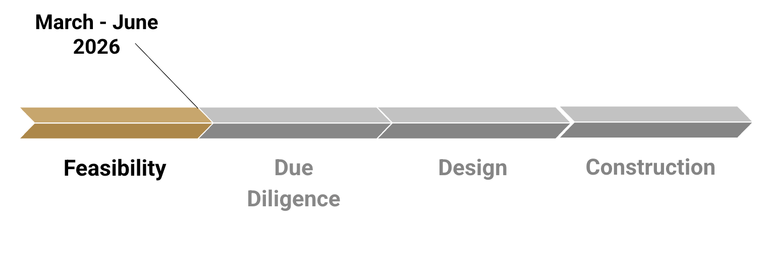
Project Phasing Diagram
March - June 2026
Feasibility
Due Diligence
Design
Construction

Slide 24
Feasibility Phase: Is This Even Possible?
Timeline: March 2026 through early June 2026
Entails:
  Confirming power and fiber optic connectivity; financial viability
  Quantifying computing needs for academic and research purposes with faculty from across the university
  Identifying industry partners for research and student internships
  Engaging with campus stakeholders via shared governance committees, town hall and survey for ideas and input.
Note: data center design, construction and specific systems will be determined in subsequent phases, i.e. design phase

Slide 25
Due Diligence Phase: Should We Do This?
Pending feasibility and Board approval to move forward
Entails:
  A deep-dive assessment entailing evaluation of site conditions and environmental impact studies

Slide 26
Design Phase
Detailed programming and design phase entails:
  Building layout, building and site design, technical systems, means and methods of construction and overall plan
  Preparation of construction documents and specifications

Slide 27
Construction Phase
Construction of the Data Center occurs during this phase
Timeline: estimated to take 12-18 months following completion of the design phase

Slide 28
Campus Engagement - Shared Governance Committees
Senate Steering Committee
Senate
SBRC
SPRC
CDEC
OU Student Congress
President’s Cabinet
Notes:
Shared Governance Committees and University Leadership Committees

Slide 29
Campus Engagement - Additional Avenues
March Town Hall
Campus Survey
Updates to OU Post and WXOU
Data Center website updates
Program assessment meetings with colleges, schools, academic committees and UTS
Notes:
Additional campus engagement

Slide 30
Q&A
Section
Notes:
NOTES FROM Q&A Session with SBRC

